Slide 1

Not just a signature!
Documenting and Filing Informed Consent Remotely
✓
EQuIP
Education and Quality
Improvement Program

Slide 2

EQuIP: Education & Quality Improvement Program
Program Purpose
to educate the research community of applicable regulations, institutional policies and of good clinical practices pertaining to the protection of human subjects
Contact Info
phone: 617-355-5308
email: eunice.newbert@childrens.harvard.edu
tonya.ferraro@childrens.harvard.edu
web: www.childrenshospital.org/research-and-innovation/research/research-administration/equip
Clinical Research Compliance
EQuIP
IRB
Program Services
Internal Study Audit/Review
New/Transfer PI Training
Study Tools and Templates
One-on-one Assistance
Education Talks/Presentations
Eunice Newbert, MPH
Manager
Tonya Ferraro, M.Ed.
Senior QI Specialist

Slide 3
Program goal
What are we doing?
  Evaluate research practices alongside the approved protocol, applicable regulation and BCH policies.
  Determine what works and what needs improvement
What can we do to help?
  Provide education and services to facilitate compliant research based on what we learn

Slide 4
Helping our Research Coordinators
Study Tools and Templates
Click: EQuIP Site_Tools and Templates
One-on-one consult
… or just reach out by email or phone
Webinar series with IRB

Slide 5
Objectives
Overview of consent process
Methods of obtaining consent
Documenting the process
    to accurately reflect what actually happened
  demonstrate compliance with process
Filing signed consent document
* Will focus on IRB-approved, written consent document

Slide 6
Informed Consent Process
Informed consent is not just a signature on a form
… it is a process of mutual communication throughout the study
Presentation of research information for subject/family to review – manner and location that ensures privacy
Discussion which allows the subject/family to ask questions or express concerns, and the investigator to respond as well as ensure subject comprehension
Adequate time for subject/family to consider
Documentation of subject/family voluntary consent

Slide 7
Informed Consent Process
Provide copy of the consent document to all required parties with adequate time for each to review the document prior to the consent discussion
Subject/legal guardian: main consent form
Child subject: if a separate assent form is required, the child must receive a copy of the assent form
Interpreter: if English is not the primary language of the subject and/or legal guardian, an interpreter should be identified prior to consent discussion

Slide 8
Informed Consent Process
Schedule consent documentation
Consent-discussion (real-time)
PI/authorized staff provides an overview of the study and reviews the consent document with subject/guardian
Subject/guardian able to ask questions
Signatures
Complete consent process (distribute copies and file as required)
Document Process

Slide 9
Methods for Obtaining Written Consent
In-person (physically face-to-face)
  IRB policy: General Information: Informed Consent and Parental Permission
Remotely (physically apart, but conversation in real-time)
  IRB policy: Remote Consent: Process and Documentation

Slide 10
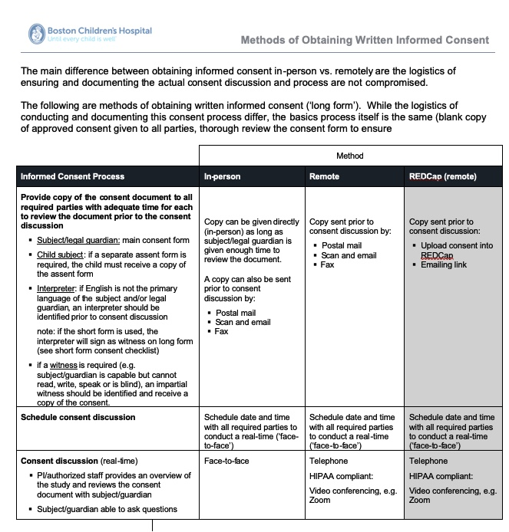
Methods for Obtaining Written Consent

Slide 11
Where to file Informed consent
Copy of signed consent to Subject/Family
Original in PI study records
Copy of signed consent in Medical Records if required

Slide 12
How do I determine when a signed consent form should be uploaded in subject’s Medical Records?
Always check approval letter and verify in CHeRP. If there is any question, contact IRB analyst to clarify
If required, ensure process is in place
If NOT required, ensure the process prevents a signed consent going into medical record (there is usually a reason the IRB will specify consent should not go in) – once uploaded, cannot be removed. Can be ‘hidden’
Recommend to know where to consent form is filed (does research staff know where to find it in medical record if requires)
Reference IRB policy: Storage of Research Data and Informed Consent Documents

Slide 13
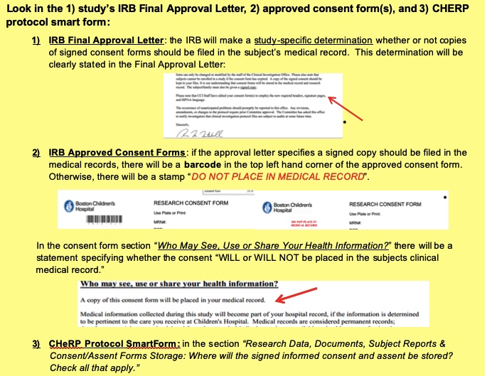

Slide 14
How to upload to Medical Records
All research consents that need to be sent from the following campuses should be in an interoffice envelope labeled Medical Records Boston.
Drop off locations at the satellites/campuses are as follows:
Lexington: 2nd floor Pediatric clinic
Peabody: Front registration desks on the first floor or second floor
Waltham: Front desk in the 2 East work room
In the event that Medical Records cannot scan your documents for any reason they will need to have a contact name and number. Please make sure that the research consents are sent with a post-it note attached that indicates where the documents are from and a call-back number where Medical Records can reach you in case they have questions for you about the documents.

Slide 15
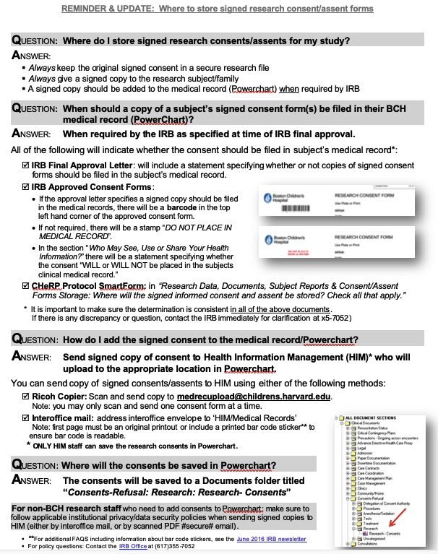

Slide 16
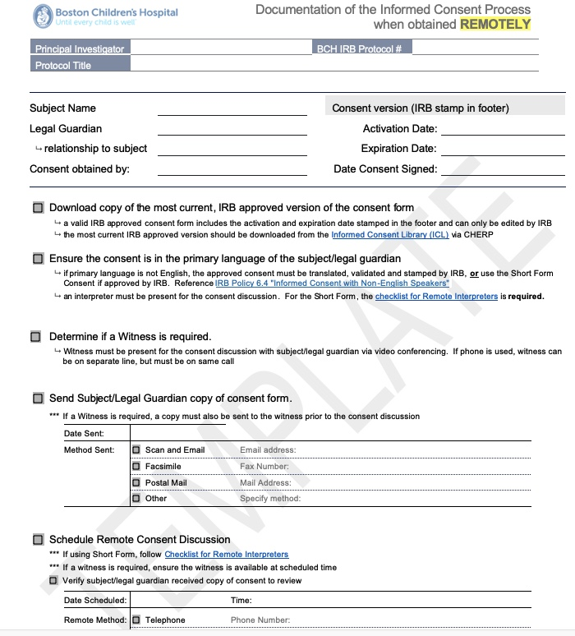
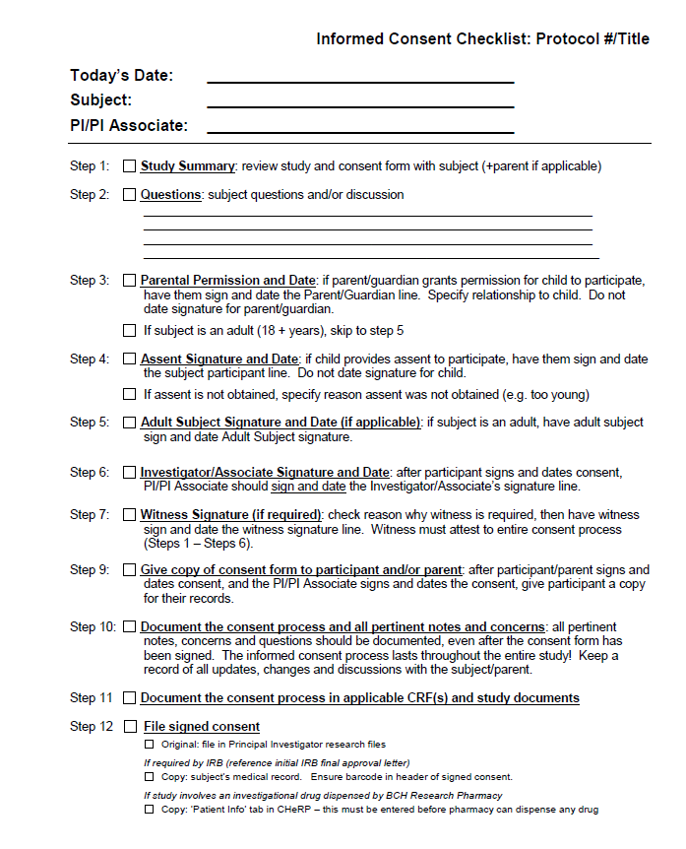
Documenting Consent Process

Slide 17
Questions?

