Slide 1
☒ Study Self-assessment
Conduct your own audit!
✓
EQuIP
Education and Quality
Improvement Program

Slide 2
Objectives
EQuIP – who we are
Why audit?
What to audit?
When to conduct self-audits

Slide 3
EQuIP: Education & Quality Improvement Program
Program Purpose
to educate the research community of applicable regulations, institutional policies and of good clinical practices pertaining to the protection of human subjects
Contact Info
phone: 617-355-5308
email: eunice.newbert@childrens.harvard.edu
tonya.ferraro@childrens.harvard.edu
web: www.childrenshospital.org/research-and-innovation/research/research-administration/equip
Clinical Research Compliance
EQuIP
IRB
Program Services
Internal Study Audit/Review
New/Transfer PI Training
Study Tools and Templates
One-on-one Assistance
Education Talks/Presentations
Eunice Newbert, MPH
Manager
Tonya Ferraro, M.Ed.
Senior QI Specialist

Slide 4
Program goal
What are we doing?
Evaluate research practices alongside the approved protocol, applicable regulation and BCH policies.
Determine what works and what needs improvement
What can we do to help?
Provide education and services to facilitate compliant research based on what we learn

Slide 5
Why self-audit?
Are you doing what you are supposed to be doing?
Do you know what you are supposed to be doing?
Find and fix ‘errors’ before they become problems
Research team education and training
Notes:
Sometimes you don’t know what is expected until someone outside tells you
It is hard to self-correct
Errors happen. On-going errors are a problem. Continuing non-compliance (definition)

Slide 6
Self-audit: Where to start

Slide 7
Purpose
Ensure compliance with applicable regulations and policies
Ensure compliance with IRB approved protocol
Identify areas you can improve
Don’t let ‘human error’ snowball into continuing non-compliance

Slide 8
What should you be doing?
Understand what you are required to do.
What requirements apply to your study?
Federal and State Regulations
Institutional Policies
Sponsor agreements/Contracts
IRB Approved Protocol

Slide 9
Standards for demonstrating compliance
Good Clinical Practices (GCP)
“international ethical and scientific quality standard for designing, conducting, recording, and reporting trials that involve human subjects. Compliance with GCP assures that the rights, safety, and well-being of trial subjects are protected and that the clinical trial data are credible. “
FDA Guidance
“the current thinking of the Food and Drug Administration (FDA or Agency) on [a particular] topic. … You can use an alternative approach if it satisfies the requirements of the applicable statutes and regulations.”
Manual of Operations (MOO) or Standard Operating Procedures (SOP)
Notes:
Talk about how we prepare –
Standard checklist we tailor prior to visit. Based on approved protocol, we tailor the checklist to what we expect to see (research type – drug → accountability log)
We tailor checklist for study documents and one for subject files
We select a % of subjects
But we aim to check 100% of consent forms

Slide 10
Self-audit: What to audit

Slide 11
Identify what to audit
Areas evaluated
Documentation
Regulatory Documents
Study Documentation: tracking progress and activity (e.g. logs)
Reporting: Unanticipated problems, Deviations, DSMB and other outside reports (sponsor monitoring, FDA inspections)
Subject-specific Files
Signed, valid consent
Data completion: CRF and source verification
Study Conduct
Informed consent process
Recruitment and screening process
Subject enrollment
General Organization and Storage
Notes:
Talk about how we prepare –
Standard checklist we tailor prior to visit. Based on approved protocol, we tailor the checklist to what we expect to see (research type – drug → accountability log)
We tailor checklist for study documents and one for subject files
We select a % of subjects
But we aim to check 100% of consent forms

Slide 12
Create a an audit tool
User-friendly for research team
Questions: be specific.
e.g. Do you have all IRB documents on file? Yes/N0
vs.
Check all the following IRB documents:
Intial IRB submission
IRB conditional Approval Letter
PI Response
IRB Final Approval Letter
Notes:
Talk about how we prepare –
Standard checklist we tailor prior to visit. Based on approved protocol, we tailor the checklist to what we expect to see (research type – drug → accountability log)
We tailor checklist for study documents and one for subject files
We select a % of subjects
But we aim to check 100% of consent forms

Slide 13
Regulatory Documents
 IRB Documents and Correspondence
IRB final approval letters for each review
- initial, amendments, continuing reviews
- ensure there is clear reference to corresponding versions of the protocol, consent/assent forms, recruitment materials as applicable
IRB determination letters and corresponding PI response for each review, as applicable
- deferral, conditional approval and pre-review comments
IRB acknowledgement letters
- unanticipated problems, SAEs, safety reports, protocol exceptions
Pertinent IRB correspondence
Notes:
Talk about how we prepare –
Standard checklist we tailor prior to visit. Based on approved protocol, we tailor the checklist to what we expect to see (research type – drug → accountability log)
We tailor checklist for study documents and one for subject files
We select a % of subjects
But we aim to check 100% of consent forms

Slide 14
Create a an audit tool
Approval Date | Date IRB Received Date IRB Sent | Document | Notes
Scientific Review: Department/Division Review
10/1/2019 |  | SciReviewApproval Letter
Initial IRB Submission
12/6/2019 | 10/7/2019 | Initial IRB Submission | SmartForm “View Submission Form”
 | 10/14/2019 | IRB Pre-review | IRB “Review Feedback Sent”
 | 11/27/2019 | PI Response to Pre-review | PI “Research Team Responded”
 | 1/14/2020 | IRB Final Approval Letter
Amendment 1: Updated travel reimbursement and new recruitment document
1/22/2020 | 1/22/2020 | Amend #1: IRB Submission | SmartForm “View Amendment Form”
 | 1/24/2020 | Amend #1: IRB Approval Letter | - see Consent Version 1
Continuing Review 1
10/18/2020 | 9/22/2020 | CReview #1: Submission | CR1 History Log: “View Snapshot of IRB Continuing Review”
 | 10/19/2020 | CReview #1: IRB Approval Letter | - see Consent Version 2
Notes:
Talk about how we prepare –
Standard checklist we tailor prior to visit. Based on approved protocol, we tailor the checklist to what we expect to see (research type – drug → accountability log)
We tailor checklist for study documents and one for subject files
We select a % of subjects
But we aim to check 100% of consent forms

Slide 15
Create a an audit tool
For each submission/review type:
Initial Review
New Protocol Submission | [Date Submitted]
IRB Determination Letter | [Date of Letter]
PI Response | [Date of Response]
IRB Final Approval Letter | [Date of Letter]
Notes:
Talk about how we prepare –
Standard checklist we tailor prior to visit. Based on approved protocol, we tailor the checklist to what we expect to see (research type – drug → accountability log)
We tailor checklist for study documents and one for subject files
We select a % of subjects
But we aim to check 100% of consent forms

Slide 16
Create an audit tool
Reportable Events
Serious Adverse Events
Unanticipated Problems (UPs)
Protocol deviations (serious and minor)
Ensure you have all reports submitted in CHeRP in your regulatory files
Identify any reportable events that may not have been submitted or identified earlier
Notes:
Talk about how we prepare –
Standard checklist we tailor prior to visit. Based on approved protocol, we tailor the checklist to what we expect to see (research type – drug → accountability log)
We tailor checklist for study documents and one for subject files
We select a % of subjects
But we aim to check 100% of consent forms

Slide 17
Create an audit tool
 All approved versions (current & expired) of:
Protocol
Informed consent and assent forms
Recruitment Materials
Manual of Operations(MOO) or
Standard Operating Procedures (SOP)
Blank copy of Case Report Forms (CRFs) and other documents used to record study activity/progress
e.g. tracking logs, visit checklists
Notes:
Talk about how we prepare –
Standard checklist we tailor prior to visit. Based on approved protocol, we tailor the checklist to what we expect to see (research type – drug → accountability log)
We tailor checklist for study documents and one for subject files
We select a % of subjects
But we aim to check 100% of consent forms

Slide 18
Create an audit tool
Protocol
from IRB review history, chronologically list IRB-approved protocol versions
Informed Consent/Assent Forms
list each consent and assent documents used at any point during this study – including translations
e.g. study cohorts/sub-groups, assent form(s), translations for each
 from IRB review history, for each consent/assent document (as applicable) chronologically list IRB-approved consent versions (activation and expiration date in footer)]
Notes:
Talk about how we prepare –
Standard checklist we tailor prior to visit. Based on approved protocol, we tailor the checklist to what we expect to see (research type – drug → accountability log)
We tailor checklist for study documents and one for subject files
We select a % of subjects
But we aim to check 100% of consent forms

Slide 19
Create an audit tool
 Study documents tracking activity and progress
Subject Screening and Enrollment Logs
Subject ID assignment list
- PI confidential “key” that links subject PHI to assigned subject ID
Research Staff: Delegation of Roles & Responsibilities
CVs and Licenses for key personnel
Recruitment Activity
Monitoring Log
Sponsor and Site Correspondence
Notes:
Talk about how we prepare –
Standard checklist we tailor prior to visit. Based on approved protocol, we tailor the checklist to what we expect to see (research type – drug → accountability log)
We tailor checklist for study documents and one for subject files
We select a % of subjects
But we aim to check 100% of consent forms

Slide 20
Create an audit tool
 if applicable, FDA regulated studies
Lab Certification and Normal Ranges
- include Lab director’s CV
FDA Form1471/1472
Drug or Device Accountability
Maintenance of equipment (e.g. calibration, inspection)
Financial agreements, budgets and contracts
IRB membership roster
Notes:
Talk about how we prepare –
Standard checklist we tailor prior to visit. Based on approved protocol, we tailor the checklist to what we expect to see (research type – drug → accountability log)
We tailor checklist for study documents and one for subject files
We select a % of subjects
But we aim to check 100% of consent forms

Slide 21
Subjects: audit tool
Subject Case History ... should read like a story
Signed informed/assent forms
Completed CRFs
Supporting source documentation
- first place data is recorded
- lab reports, medical records, clinic notes, diagnostic reports
Study visit notes/checklists
Applicable note-to-files
SAE/unanticipated problems if applicable
Notes:
Talk about how we prepare –
Standard checklist we tailor prior to visit. Based on approved protocol, we tailor the checklist to what we expect to see (research type – drug → accountability log)
We tailor checklist for study documents and one for subject files
We select a % of subjects
But we aim to check 100% of consent forms

Slide 22
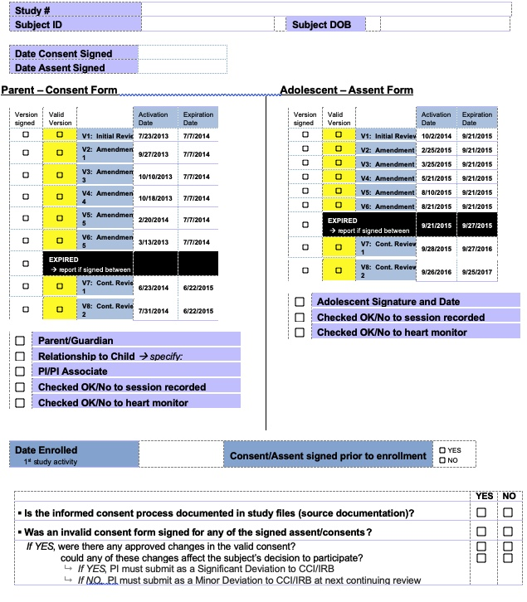

Slide 23
Areas to audit
 Required Study Documents
IRB Documents
Other Study Reports
Protocol
Consent/Assent Forms
Approved Recruitment materials
Study Documents/Logs
Regulatory Documents
 Protocol Adherence and Study Conduct
Adequate documentation/records to demonstrate:
Study conduct was in compliance with approved protocol and institutional policies
Accurate subject enrollment and visit status
 Study Documentation and Organization
Clear and complete documentation per GCP and safe and secure storage of documents and study materials
 Data Reliability
Source data/documents verify complete, consistent and accurate data as to ensure
Subject exists
Subject consent
Subject eligibility
Complete CRFs with corresponding Source data

Slide 24
Thank You!

