Slide 1

5 Best Practices for Research Coordinators @BCH
Tips & Hints
✓
EQuIP
Education and Quality
Improvement Program

Slide 2

EQuIP: Education & Quality Improvement Program
Program Purpose
to educate the research community of applicable regulations, institutional policies and of good clinical practices pertaining to the protection of human subjects
Contact Info
phone: 617-355-5308
email: eunice.newbert@childrens.harvard.edu
tonya.ferraro@childrens.harvard.edu
web: www.childrenshospital.org/research-and-innovation/research/research-administration/equip
Clinical Research Compliance
EQuIP
IRB
Program Services
Internal Study Audit/Review
New/Transfer PI Training
Study Tools and Templates
One-on-one Assistance
Education Talks/Presentations
Eunice Newbert, MPH
Manager
Tonya Ferraro, M.Ed.
Senior QI Specialist

Slide 3
Our goal
What are we doing?
  Evaluate research practices alongside the approved protocol, applicable regulation and BCH policies.
  Determine what works and what needs improvement
What can we do to help?
  Provide education and services to facilitate compliant research based on what we learn

Slide 4
Helping our Research Coordinators
Study Tools and Templates
Click: EQuIP Site_Tools and Templates
One-on-one consult
… or just reach out by email or phone
EQuIP Drop-in Hours
Webinar series with IRB

Slide 5
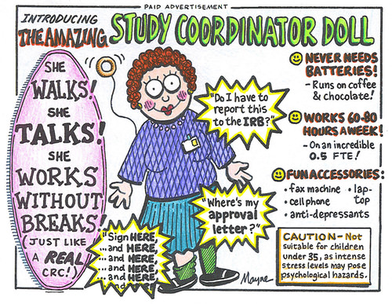

Slide 6
1. Do YOUR job

Slide 7
Scope of Responsibility
Ask what your responsibilities are
… from the right person (PI or manager)
Delegation of Roles and Responsibilities Log
  know your defined role, and everyone else’s role
  don’t assume more responsibilities than delegated
  Update in real-time. Should be reviewed at every staff meeting.
  Stay in your lane

Slide 8
Know what applies
Understand what you are required to do.
What requirements apply to your study?
    Federal and State Regulations
    Institutional Policies
    Sponsor agreements/Contracts

Slide 9
Know what you should do
Say what you will do …
    IRB-approved protocol
    - amendments, on-going practices
    Sponsor/Investigator-level SOPs
… then do what you say

Slide 10
Document
Document
Document

Slide 11
Study Data: Conduct + Results
Study Plan
documenting what we think will happen
Protocol states question and what you intend to do
SOPs outlines how you intend to do it
Study Data
documenting what actually happens
Study Conduct what you did and how
Study Results what actually happened

Slide 12
Source Data
1.51 Source Data
All information in original records and certified copies of original records of clinical findings, observations, or other activities in a clinical trial necessary for the reconstruction and evaluation of the trial. Source data are contained in source documents (original records or certified copies).
(ICH-GCP E6)

Slide 13
Scenario
Source Data and Documents
Case Report Forms (CRFs)
Data Entry/Analysis
Publication/Study Report

Slide 14
When do you really need source
Prove subject exists
Prove the subject gave consent
Prove subject meets eligibility
Prove your data

Slide 15
Prove it.

Slide 16
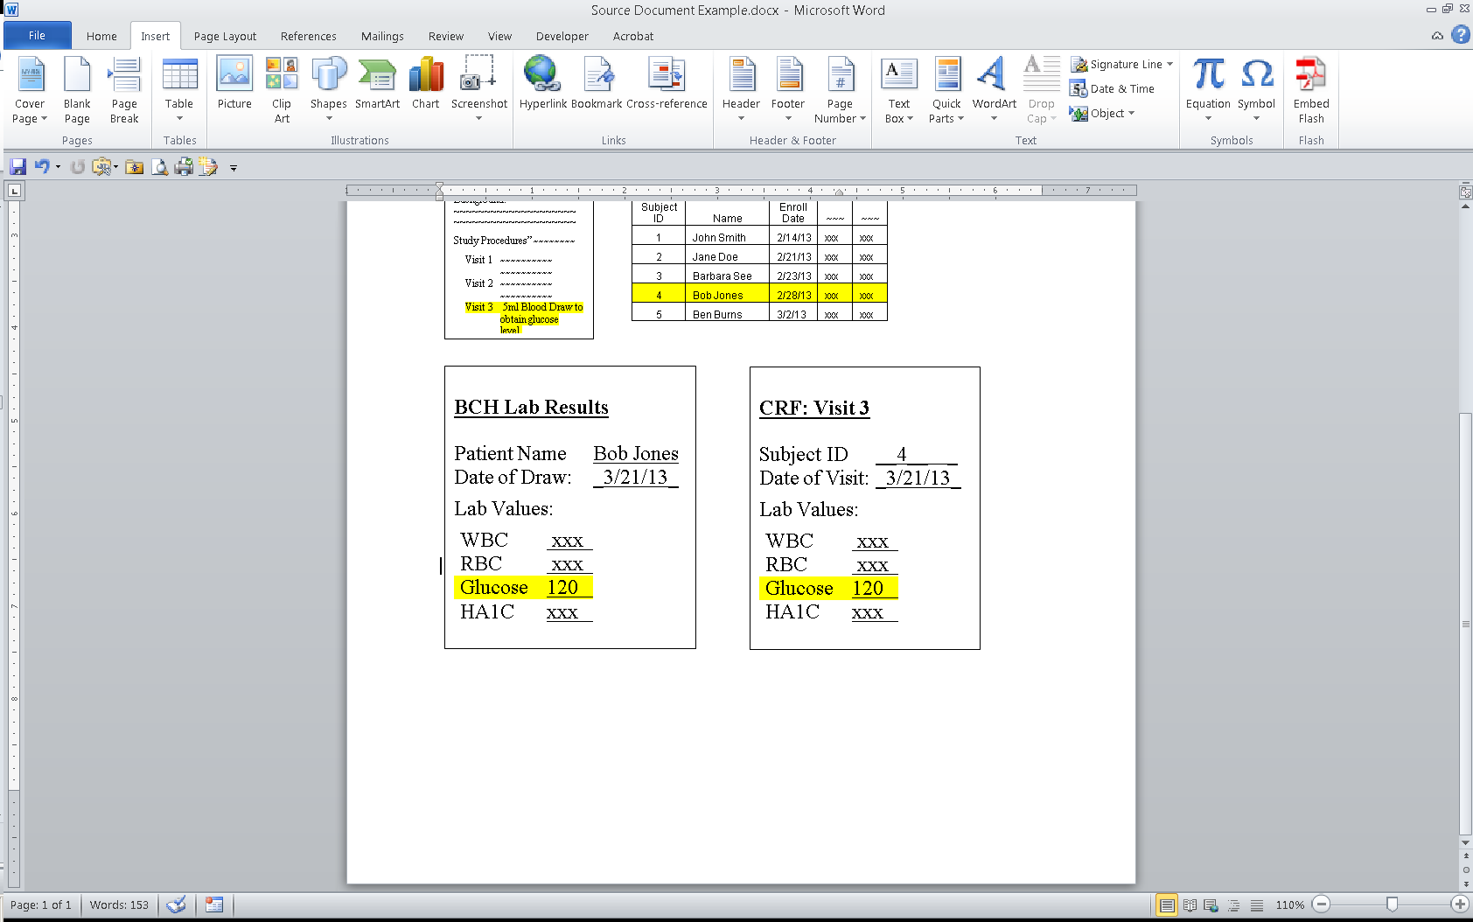
Study Documents
Approved protocol: glucose will be measured at V3 which should be 3 weeks after enrollment.
Mr. Bob Jones is an enrolled subject in this study and just completed V3 today.
Protocol: Glucose Changes
Background: ~~~~~~~~~~~~~
~~~~~~~~~~~~~~~~~~~~
~~~~~~~~~~~~~~~~~~~~
Study Procedures” ~~~~~~~~
Visit 1 ~~~~~~~~~~
~~~~~~~~~~
Visit 2 ~~~~~~~~~~
~~~~~~~~~~
Visit 3 5ml Blood Draw to obtain glucose level.
Subject Enrollment Log
Protocol #101010: Glucose Changes
PI: Dr. Med Researcher
Subject ID | Name | Enroll Date | ~~~ | ~~~
1 | John Smith | 2/14/13 | xxx | xxx
2 | Jane Doe | 2/21/13 | xxx | xxx
3 | Barbara See | 2/23/13 | xxx | xxx
4 | Bob Jones | 2/28/13 | xxx | xxx
5 | Ben Burns | 3/2/13 | xxx | xxx
APPROVED

Slide 17
Subject Case History
..... should read like a story
Signed informed/assent forms
Completed CRFs
Supporting source documentation
- first place data is recorded
Study visit notes/checklists
Applicable note-to-files
SAE/unanticipated problems if applicable

Slide 18
Study Documentation
Fill in the gaps
  If something did not go according to plan (i.e. approved protocol, SOP), DOCUMENT WHY
  Note-to-files (e.g. memo-to-self/PI)
  Never let an auditor/monitor/inspector ask why something went off script … your documentation should answer the question and should be filed in a place it will make since. (e.g. with study visit in subject binder vs. in note-to-file tabs in the regulatory binder)

Slide 19
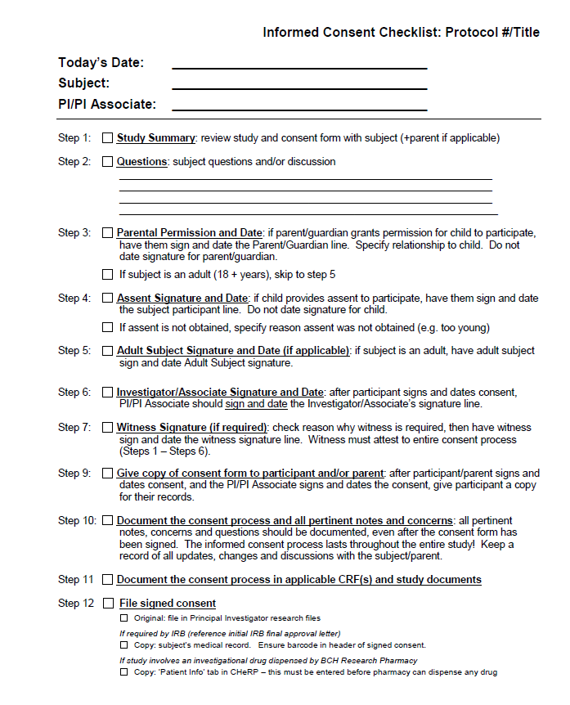

Slide 20
Study Documentation
Ensure Complete & Accurate Documentation
Study Documents must represent what happened
  All data collection forms should be complete
  No blanks! Missing values must be explained
  e.g. not obtained, n/a, missing
  Data Corrections made correctly
  Clear audit trail
  Never white-out, black-out or obscure corrected values. All values must be transparent.

Slide 21
Time

Slide 22
Time management
Be realistic – what can you get done
Don’t rush through subject visits
Schedule time each day for paperwork. Never forget paperwork!
Be flexible -

Slide 23
The Big Picture

Slide 24
Scenario
Source Data and Documents
Case Report Forms (CRFs)
Data Entry/Analysis
Publication/Study Report

Slide 25
Can you see the forest?
Be realistic – what can you get done
Prioritize – what will make a difference
Don’t get stuck on the small stuff
Never panic, be flexible and always communicate with PI and research team.
Think backwards

Slide 26
There is never a stupid question

Slide 27
Ask, ask, ask
Ask your PI how THEY want things
  Naming conventions, files organized
Ask what resources are available to you
- Who can you ask?
- EQuIP, ICCTR, Google!
Keep asking because every study and every team is different
Keep asking until you get the same answer twice!
Notes:
Never

Slide 28
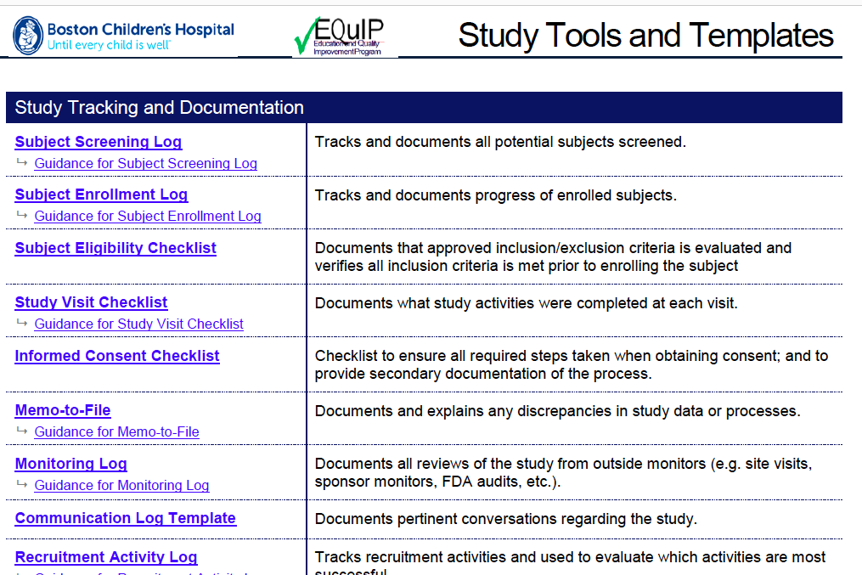
Study Tools and Templates

Slide 29
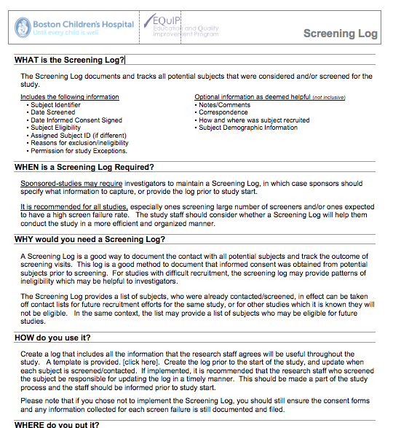
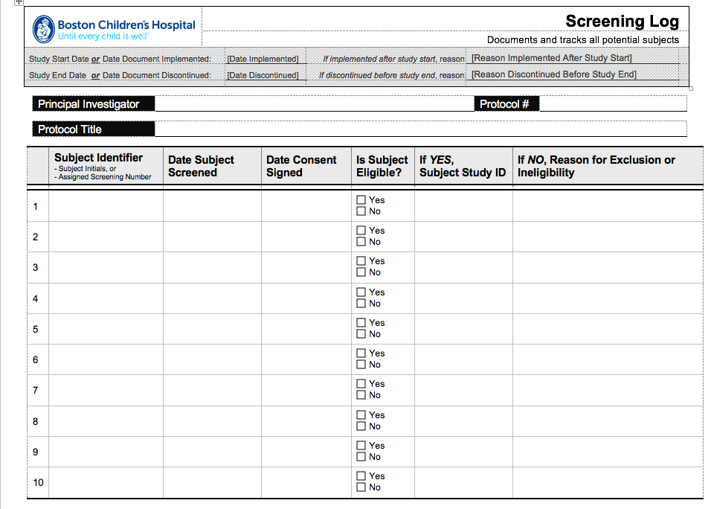
Study Tools and Templates

Slide 30
Questions?
Eunice Yim Newbert, MPH 5-3022
eunice.newbert@childrens.harvard.edu
Tonya Ferraro, M.Ed 5-5308
tonya.ferraro@childrens.harvard.edu

