Slide 1
Sharing Data & Biospecimens
November 3, 2021
Jesse Ripton, Manager of External Relations, Policy & Quality
Theresa Applegate, Senior Director, Office of Sponsored Programs
Paul Santos, Associate Director, Office of Sponsored Programs

Slide 2
Objectives
Frame the regulatory & ethical issues related to the sharing of data and biospecimens in research
Identify drivers & challenges of BCH’s approach to individual participant level data sharing
Review Guidance: Data Sharing Requirements for Individual Participant Level Data
Review updated template consent form language
Provide practical guidance for research protocols
Review the NIH Genomic Data Sharing Policy & BCH Institutional Certification Process
Q&A

Slide 3
Few things are more confusing than the requirements for sharing data!

Slide 4
Regulatory Consideration- Data & Biospecimen Sharing
IRB Review
HHS 45 CFR 46\ FDA 21 Part 56
Privacy Laws
HIPAA, FERPA and GDPR
Notes:
When is IRB review required?
All research with human data/biospecimen determined to constitute research with human subjects require prospective IRB review and approval or exemption determination
Privacy Laws
Health Information Portability and Accountability Act (known as "HIPAA") applies if the data included is individually identifiable health information. When PHI is used in research, there are specific requirements regarding the use and disclosure of data and how data may be de-identified. Use or Disclosure of PHI for research activities requires an authorization or waiver of authorization except when the investigator enters into a data use agreement in conjunction with a limited data set.
The Family Educational Rights and Privacy Act (FERPA) is a federal law regarding the privacy of student record. In general In order for a researcher to access student records for which they do not already have legitimate educational interest, they must obtain signed and dated permission from the parent or eligible student for the release of their records.
General Data Protection Regulation (GDPR) of the European Union has additional considerations related to when data includes information about human subjects who reside in Europe.

Slide 5
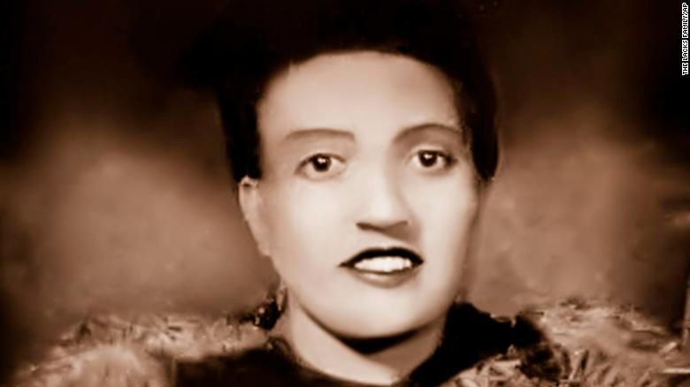
HeLa Cells- The Immortal Life of Henrietta Lacks
Balance of Respect for Person and Medical Discovery
The experience of the Lacks Family raised deep questions about the collection, storage and use of stored biospecimens and informed consent, regulatory oversight, large-scale data sharing, privacy and confidentiality, commercialization, and ultimately access to research results.
Notes:
That “HeLa” cell line became a scientific breakthrough: the first immortal line of human cells to divide indefinitely in a laboratory. The cells were mass produced, for profit, without recognition to her family. Over 50,000,000 metric tonnes of HeLa cells have been distributed around the world, the subjects of over 75,000 studies.
In addition to the HPV vaccine, HeLa cells allowed for development of the polio vaccine; drugs for HIV/AIDS, haemophilia, leukaemia, and Parkinson’s disease; breakthroughs in reproductive health, including in vitro fertilization; research on chromosomal conditions, cancer, gene mapping, and precision medicine; and are used in studies responding to the COVID-19 pandemic.

Slide 6
Consent Requirements
What do you need to tell participants about how their data and samples will be used?
Revision to the Common Rule (HHS 45 Part 46) implemented in January 2020 added additional required information to the consent form. Researchers must tell participants:
Whether subject’s data/biospecimens will or will not be stripped of identifiers shared and used for future research.
Additional requirements, as applicable:
Whether a subject’s biospecimens (even if identifiers are removed) may be used for commercial profit and whether the subject will or will not share in this commercial profit;
Whether clinically relevant research results, including individual research results, will be disclosed to subjects, and if so, under what condition;
Whether the research will (if known) or might include whole genome sequencing (i.e., sequencing of a human germline or somatic specimen with the intent to generate the genome or exome sequence of that specimen).

Slide 7
Consent Requirements
Journals, funders and central repositories may also have requirements
Under the NIH GDS policy, data collected after January 25, 2015 should be collected with consent that states what data types will be shared (e.g., genomic, phenotype, health information, etc.), for what purposes (e.g., General Research Use, Disease-Specific research use, etc.), and whether sharing will occur through open (unrestricted) or controlled access databases.
Journals, external funders or central repositories or data platforms (The Human Cell Atlas) may also require consent for open-access sharing.

Slide 8
Drivers of change
Shaping BCH’s approach to individual participant level data sharing
Evolving consent requirements:
Very little/ nothing in consent forms to now generally held principle that when data/biospecimens are used from an IRB approved protocols the uses must be consistent with the permissions described in the informed consent.
NIH policies:
NIH GDS Policy (2015)
Update to NIH Management of Genomic Summary Results Access (2018)
Final NIH Policy for Data Management and Sharing (October 2020/ effective date: January 25, 2023)
Increasingly there is a requirement for data (sometimes biospecimens) sharing through central repositories as term of award/grant/funding across multiple external funders. Sharing is now more common via public or unrestricted access central repositories.
Journal requirements for data sharing
ICMJE data sharing requirements for clinical trials (2018

Slide 9
Challenges
Shaping BCH’s approach to individual participant level data sharing
Investigators not aware of all data sharing requirements and as a result protocol/consent may not accurately reflect the scope of required data sharing.
Default language in informed consent template intended for data sharing through controlled access repository and no specific language when data will be shared through unrestricted access.
Lack of awareness on the differences between sharing data in a controlled access v. unrestricted access.
Investigator seeking to deposit data to dbGAP from a protocol which collects data/biospecimens from multiple sources with no/different language on uses of data/biospecimens for future research.

Slide 10
New Guidance: Data Sharing Requirements for Individual Participant Level Data
Developed to provide guidance on how to respond to individual participant-level research data sharing requirements regardless of funding.
Individual participant level data is raw data from individual participants- includes demographic information for each participant and information about evaluations/treatments or tests received as part of the research and the outcomes observed.
Not appliable for for sharing of methods, protocol-related documents, summary, aggregate or statistical analyses.
The IRB office will be asked to confirm that the approved protocol and consent allow sharing of individual level data as proposed by the investigator – this is likely occurring at time of data deposit.
If sharing NOT included in approved protocol/consent an amendment may be required- responsive to current principles that uses should be consistent with the consent originally obtained from participants.
Provides information on the NIH GDS policy requirement including the process for requesting the Institutional Certification which must accompany the submission of all large-scale human data to the NIH designated repository.

Slide 11
New Guidance: Data Sharing Requirements for Individual Participant Level Data
What information should be in the protocol?
What applicable requirements exist for sharing individual level data?
What individual level data might be shared?
Who would you likely share data with?
What would be the likely mechanism to share data for example a controlled or open access system?
Do you anticipate there may be sensitive data that would not be shared at the individual level?
Is there an increased risk of de-identification based on same numbers or rare conditions*?
From a practical standpoint we would recommend you put this in your protocol document– for some applications (Establishment of Repository Protocol, New Research Application- Limited) some of this information we will be

Slide 12
New Guidance: Data Sharing Requirements for Individual Participant Level Data
Outlines consideration for data sharing mechanisms:
Controlled Access is a restricted access process in which a scientist requests access to query the data and signs a data use agreement
Open Access is an unrestricted access process in which anyone can request or download the data without any vetting of the use or scientist, or an agreement. Examples of this include a foundation website or NIH GEO(Gene Expression Omnibus).
Open Access/Unrestricted Access requires explicit statement in the consent form!
Data Available Upon Request is process is used when a PI provides contact information and provides data pursuant to request.
Links investigators to the Data Use Transfer Questionnaire to determine what agreement may be required for the sharing of data.

Slide 13
Updated: Informed consent template data sharing language
Will my samples/information be used for research in the future section now requires
Whether information and/or biospecimens collected for the study may be shared and used for future research
Whether information and/or biospecimens will be used broadly for future research use or whether the future research use will be limited to specific conditions or diseases
Identification of who participants can contact with questions about the use of their information and/or biospecimens in future research and whether they can request their information and/or biospecimens be withdrawn.
Information on the sharing of information with a central registry, database or repository and whether that sharing will be through controlled access or unrestricted access.
This language can and should be adapted and refined- we welcome suggestions of how we can approve readability and use of plain language.
As technology and science evolve, we anticipate further changes and tweaks to language- we encourage broad and flexible language!

Slide 14
Consent Form - continued

Slide 15
Consent Form - continued

Slide 16
Consent Form - continued

Slide 17
Consent Form - continued

Slide 18
Application of Data Sharing Guidance
Older research protocols with no consent and/or limited language on sharing
IRB recognizes that the principles and regulatory oversight has shifted and that it is not possible to re-contact participants in every study to seek new consent for sharing.
IRB will continue to evaluate data/biospecimen sharing in terms of whether the proposed use/sharing is not inconsistent with scope of consent/protocol approval. The IRB will consider:
Whether consent was obtained
If the consent obtained was silent or limited sharing
Proposed use/sharing of the data/biospecimen
Explicit statements that data/biospecimens will NOT be shared or used past the immediate study will continue to be honored.
In general lack of consent limits the sharing of data/biospecimens.

Slide 19
Practical Tips for IRB Protocols
Keep in mind data sharing is now the new normal
Understand your funder’s data sharing requirements up front
Don’t limit sharing unnecessarily – take the broad consent approach by leveraging consent template language
Address data sharing in the protocol document
For protocols limited to collection of existing data/biospecimens collected under another research protocol:
Carefully consider the consent language in the originally consent form
What did participants consent to? What is limited?
Make sure your IRB application outlines this information, seek guidance from the IRB as needed
New sources of data/biospecimens should be added to the protocol OR submitted as a new protocol

Slide 20
Practical Tips- Ongoing Studies
You are not required to update your consent form with new consent template language!
We would suggest that you carefully consider your current protocol/consent and determine if a revision is needed to align your protocol/consent with your current or proposed future data sharing plans. As part of this process, you may consider revisiting external funder or specific central repository consent requirements related to data sharing.
The IRB office is available to discuss protocol specific questions related to data sharing.

Slide 21
Key Features of the NIH Genomic Data Sharing (GDS) Policy:
It promotes sharing, for research purposes, of large-scale human and non-human genomic data generated from NIH-funded research.
It sets forth expectations that ensure the broad and responsible sharing of genomic research data.
It supports the NIH mission of sharing research data, which is essential to facilitate the translation of research results into knowledge, products, and procedures that improve human health.
It is consistent with NIH policies to make a broad range of research data, in addition to genomic data, publicly available in a timely manner from the research activities that it funds.

Slide 22
The Genomic Data Sharing (GDS) Policy Applies to:
NIH-funded research grants and contracts that involve the generation of large-scale, human and/or non-human genomic data, regardless of funding level, as well as there use of these data for subsequent research.
What’s Considered Large Scale? Genome-wide association studies (GWAS), single nucleotide polymorphisms (SNP) arrays, and genome sequence, transcriptomic, epigenomic, and gene expression data.
Research Examples:
Data from 300,000 or more variant sites in more than 1,000 human research participants.
Sequence data from more than 100 genes or regions of comparable size in the genomes of more than 100 research participants.

Slide 23
Genomic Data Sharing (GDS) and Grant Mechanisms:
Applicable to:
Research projects (R)
Program projects (P)
Cooperative agreements (U)
Individual career development awards (K)
Research contracts (N) and other activities that include a research component
Not Applicable to:
Institutional training grants (T32)
Institutional career development awards (K12)
Individual Fellowships (F)
Resource grants and contracts (S)

Slide 24
Institutional Certifications:
When Are Institutional Certifications Required for NIH-Funded Research Projects?
Just-In-Time Stage: Institutional Certification is required to describe the appropriate research use of the data and to assure that the proposal for data submission and sharing is consistent appropriate, with applicable national, tribal, and state laws and regulations as well as relevant Institutional policies
What Are We Certifying?
Whether data will be submitted to an Unrestricted or Controlled-Access Database.
That any limitations on the research use of the data, as expressed in the informed consent documents, are delineated
That the identities of research participants will not be disclosed to NIH-designated repositories
That the IRB has reviewed the investigator’s proposal for data submission and assures that:
The protocol for the collection of genomic and phenotypic data is consistent with 45 CFR Part 46;
Data submission and subsequent data sharing for research purposes are consistent with the informed consent of study participants from whom the data were obtained;
Consideration was given to risks to individual participants and their families associated with data submitted to NIH-designated data repositories and subsequent sharing;
To the extent relevant and possible, consideration was given to risks to groups or populations associated with submitting data to NIH-designated data repositories and subsequent sharing; and
The investigator’s plan for de-identifying datasets is consistent with the standards outlined in NIH GDS Policy.

Slide 25
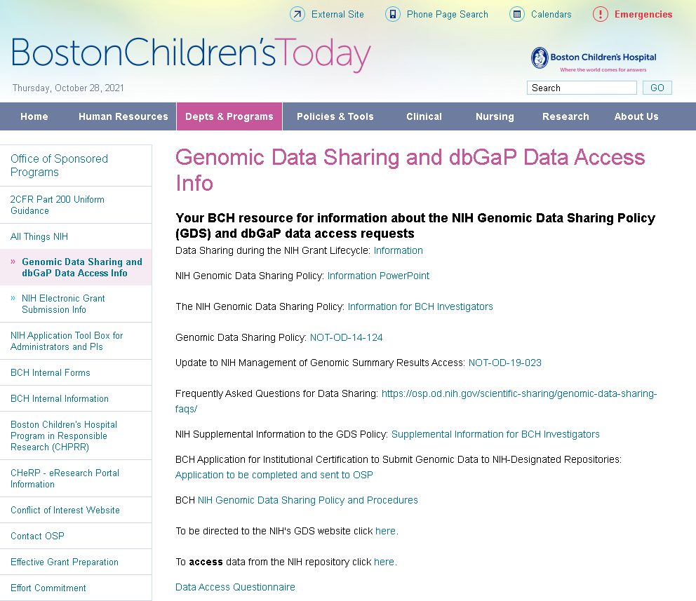
Institutional Certifications, continued:
The Office of Sponsored Programs (OSP), The Institutional Review Board (IRB), Research Administration (RA) work together with Principal Investigators to collect information and prepare & provide certifications.
How?

Slide 26
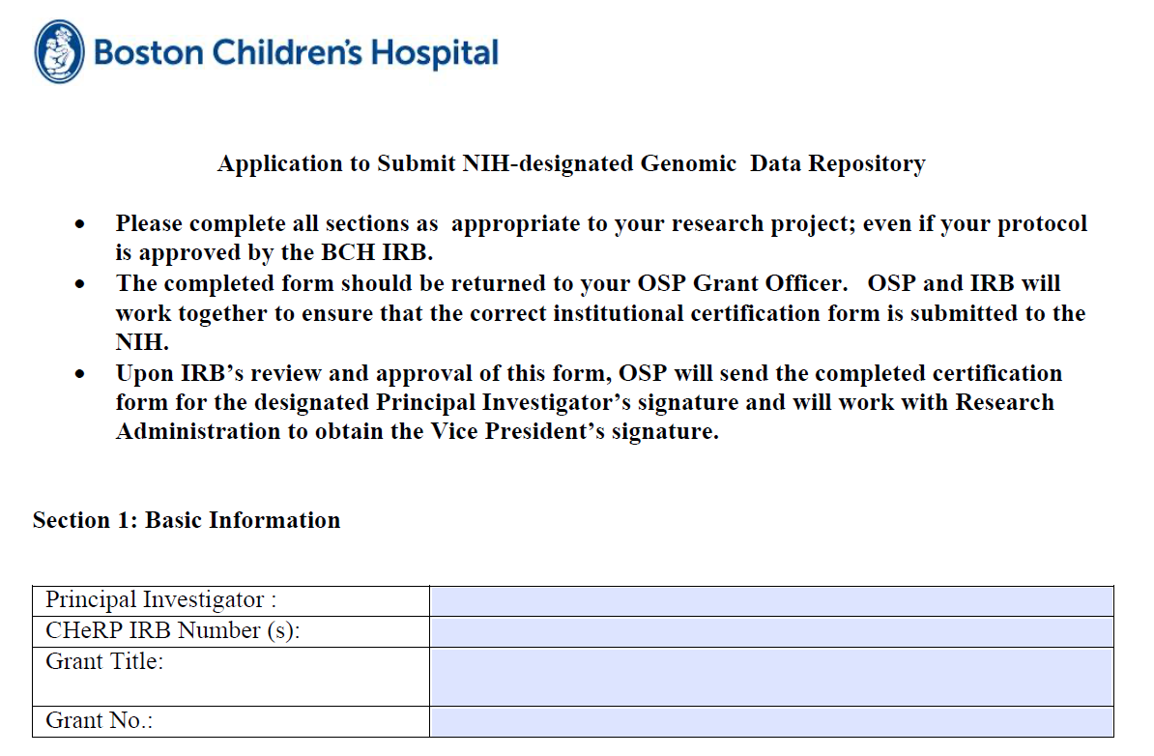
The BCH Institutional Certification Form: Section 1
The Form has Four Sections:
Basic Information
Research Data
Informed Consent
De-Identifying Datasets
Basic Information

Slide 27
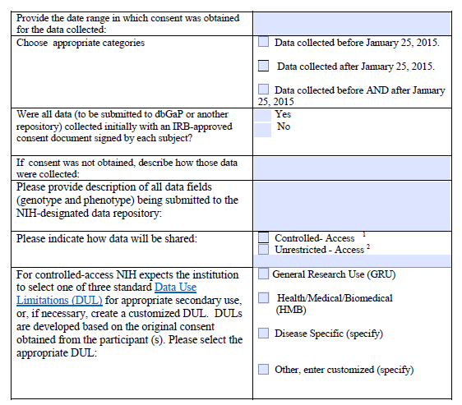
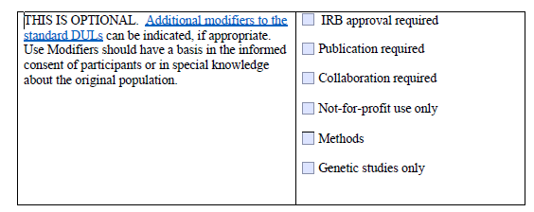
The BCH Institutional Certification Form: Section 2
Research Data for Institutional Certifications

Slide 28
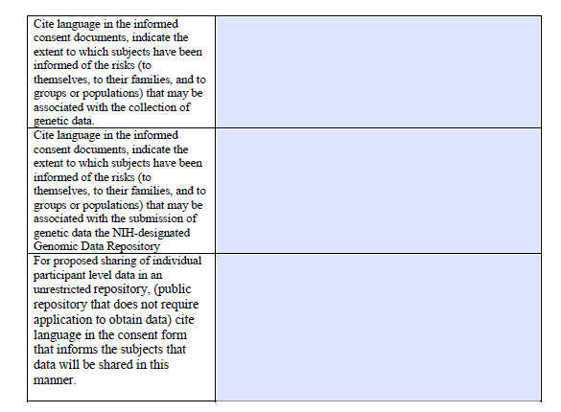
The BCH Institutional Certification Form: Section 3
Informed Consent

Slide 29
The BCH Institutional Certification Form: Section 4
De-Identifying Datasets
Next Steps:
Return completed forms to your OSP Grant Officer
OSP works with IRB to ensure that GDS requirements are in place and to determine the appropriate NIH certification template to use
OSP works with Principal Investigators and Research Administration to obtain signatures

Slide 30
Resources
NIH Genomic Data Sharing: https://osp.od.nih.gov/scientific-sharing/genomic-data-sharing/
Institutional Review Board (IRB): http://www.childrenshospital.org/research/institutional-review-board
Office of Sponsored Programs (OSP): http://web2.tch.harvard.edu/osp/
Clinical Trials Business Office (CTBO): http://web2.tch.harvard.edu/researchadmin/mainpageS2700P141.html
Technology Innovations Development Office (TIDO): http://tido.childrenshospital.org/

