Slide 1


THE RHINO STUDY

Slide 2

Hello!
Thank you for participating in the RHINO Study!

Slide 3
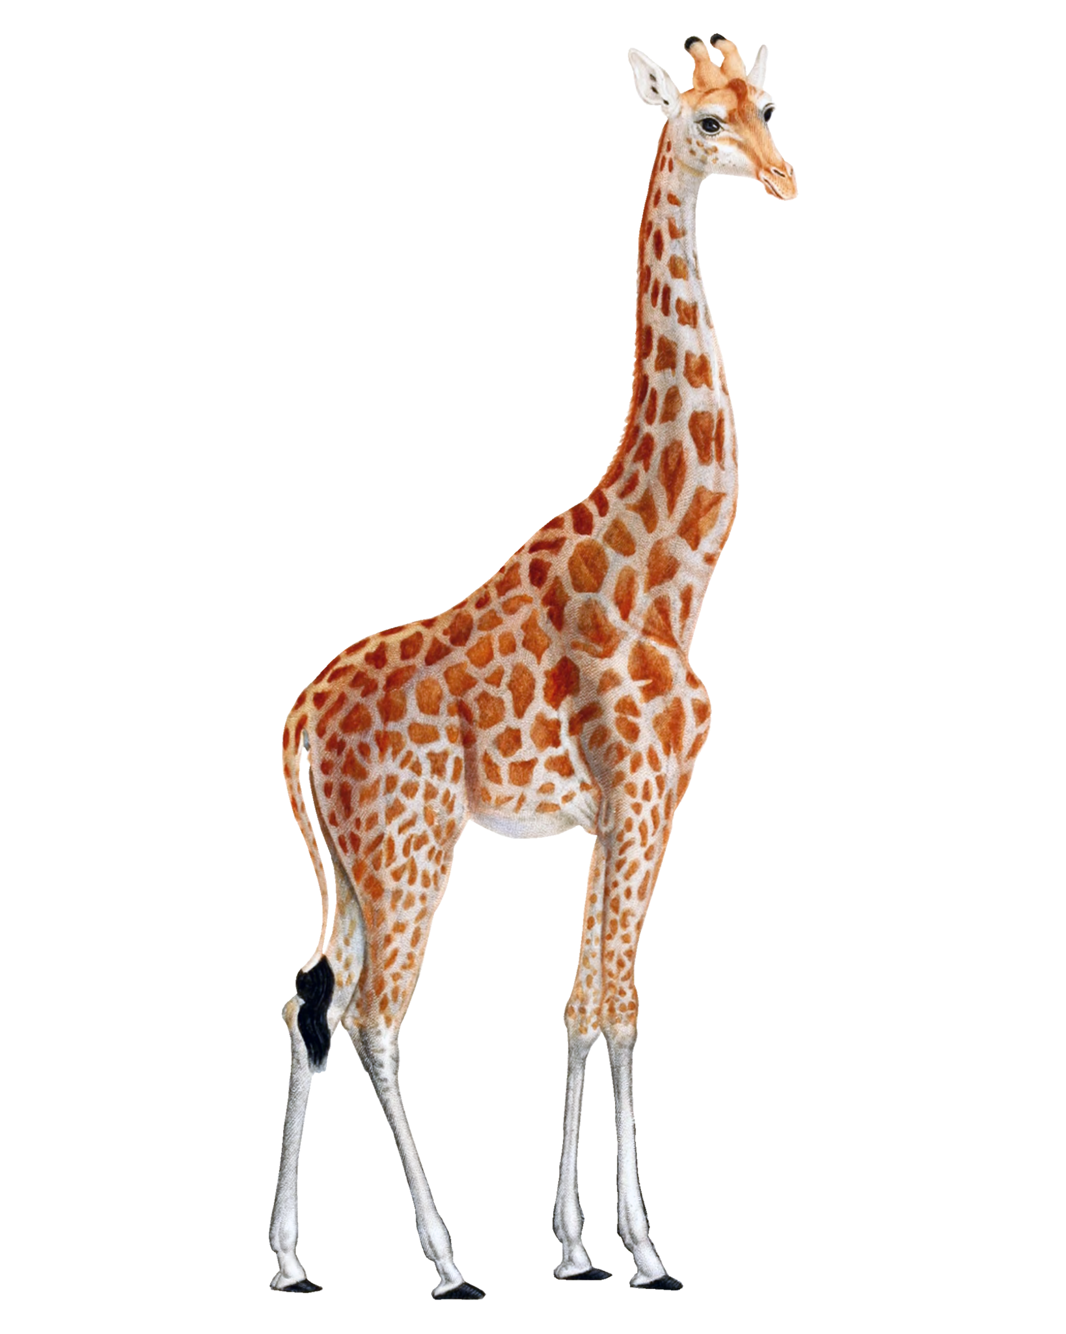
What is the study for?

Slide 4
The RHINO study is a science study to figure out how kids’ brains can be different or the same. People are similar in some ways and different in other ways.

Slide 5
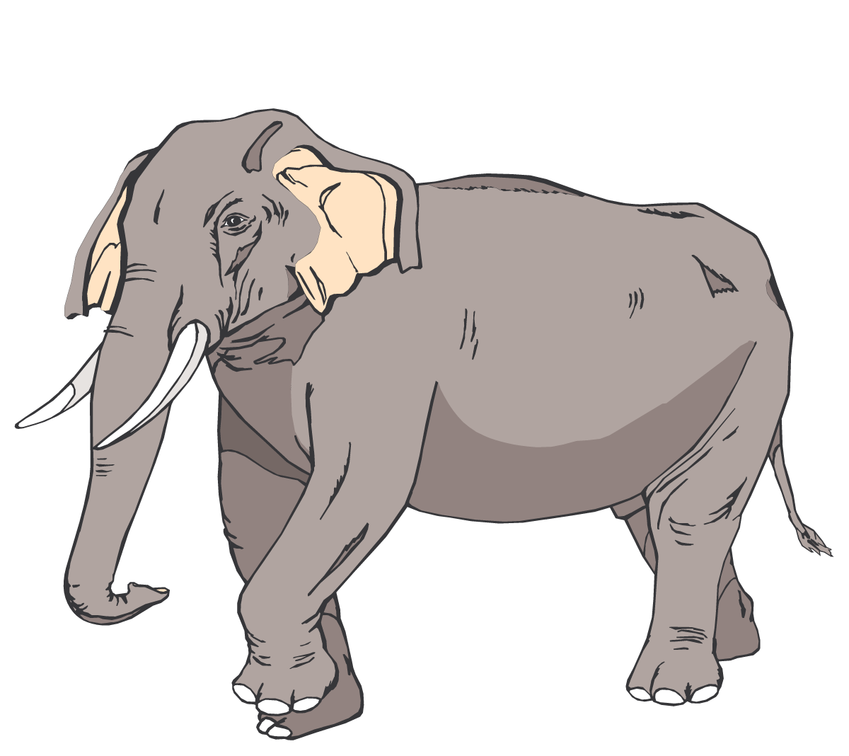
KIDS ARE ALL DIFFERENT!
Have you ever noticed you can really pay attention to some things and not others?
Everyone, even adults, can be different in how they pay attention and control their bodies.

Slide 6
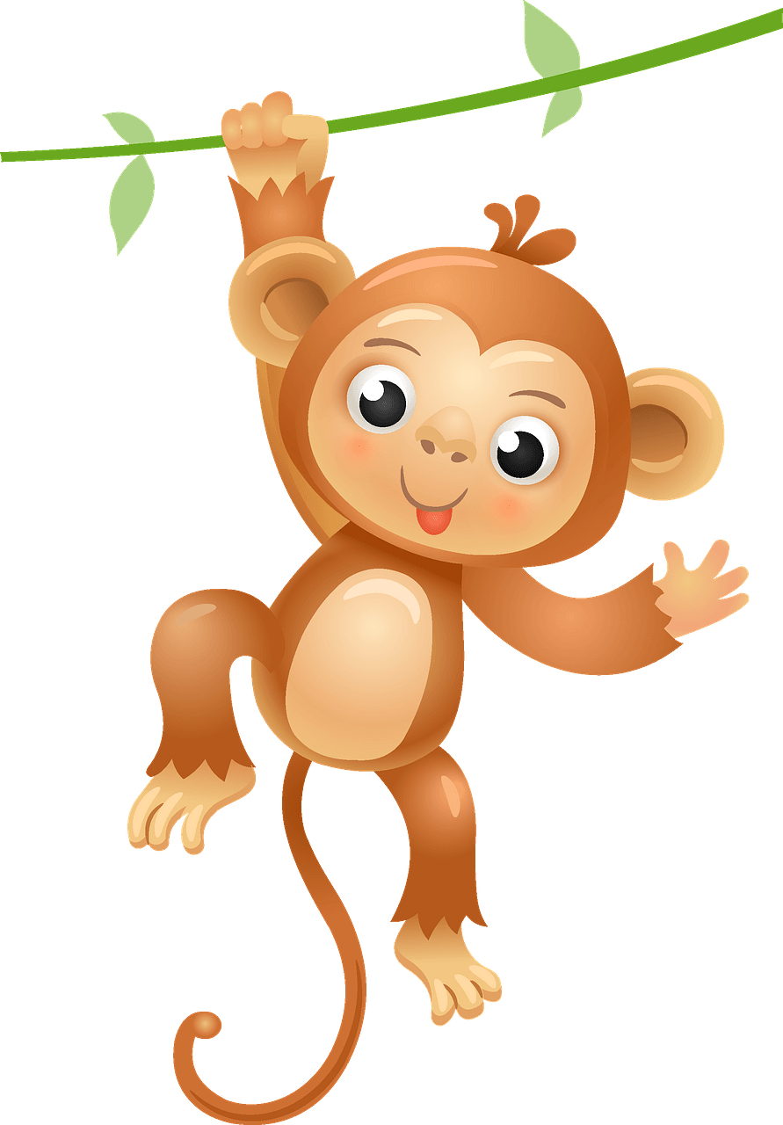
We want to study these differences in kids!
WE NEED YOUR HELP!

Slide 7
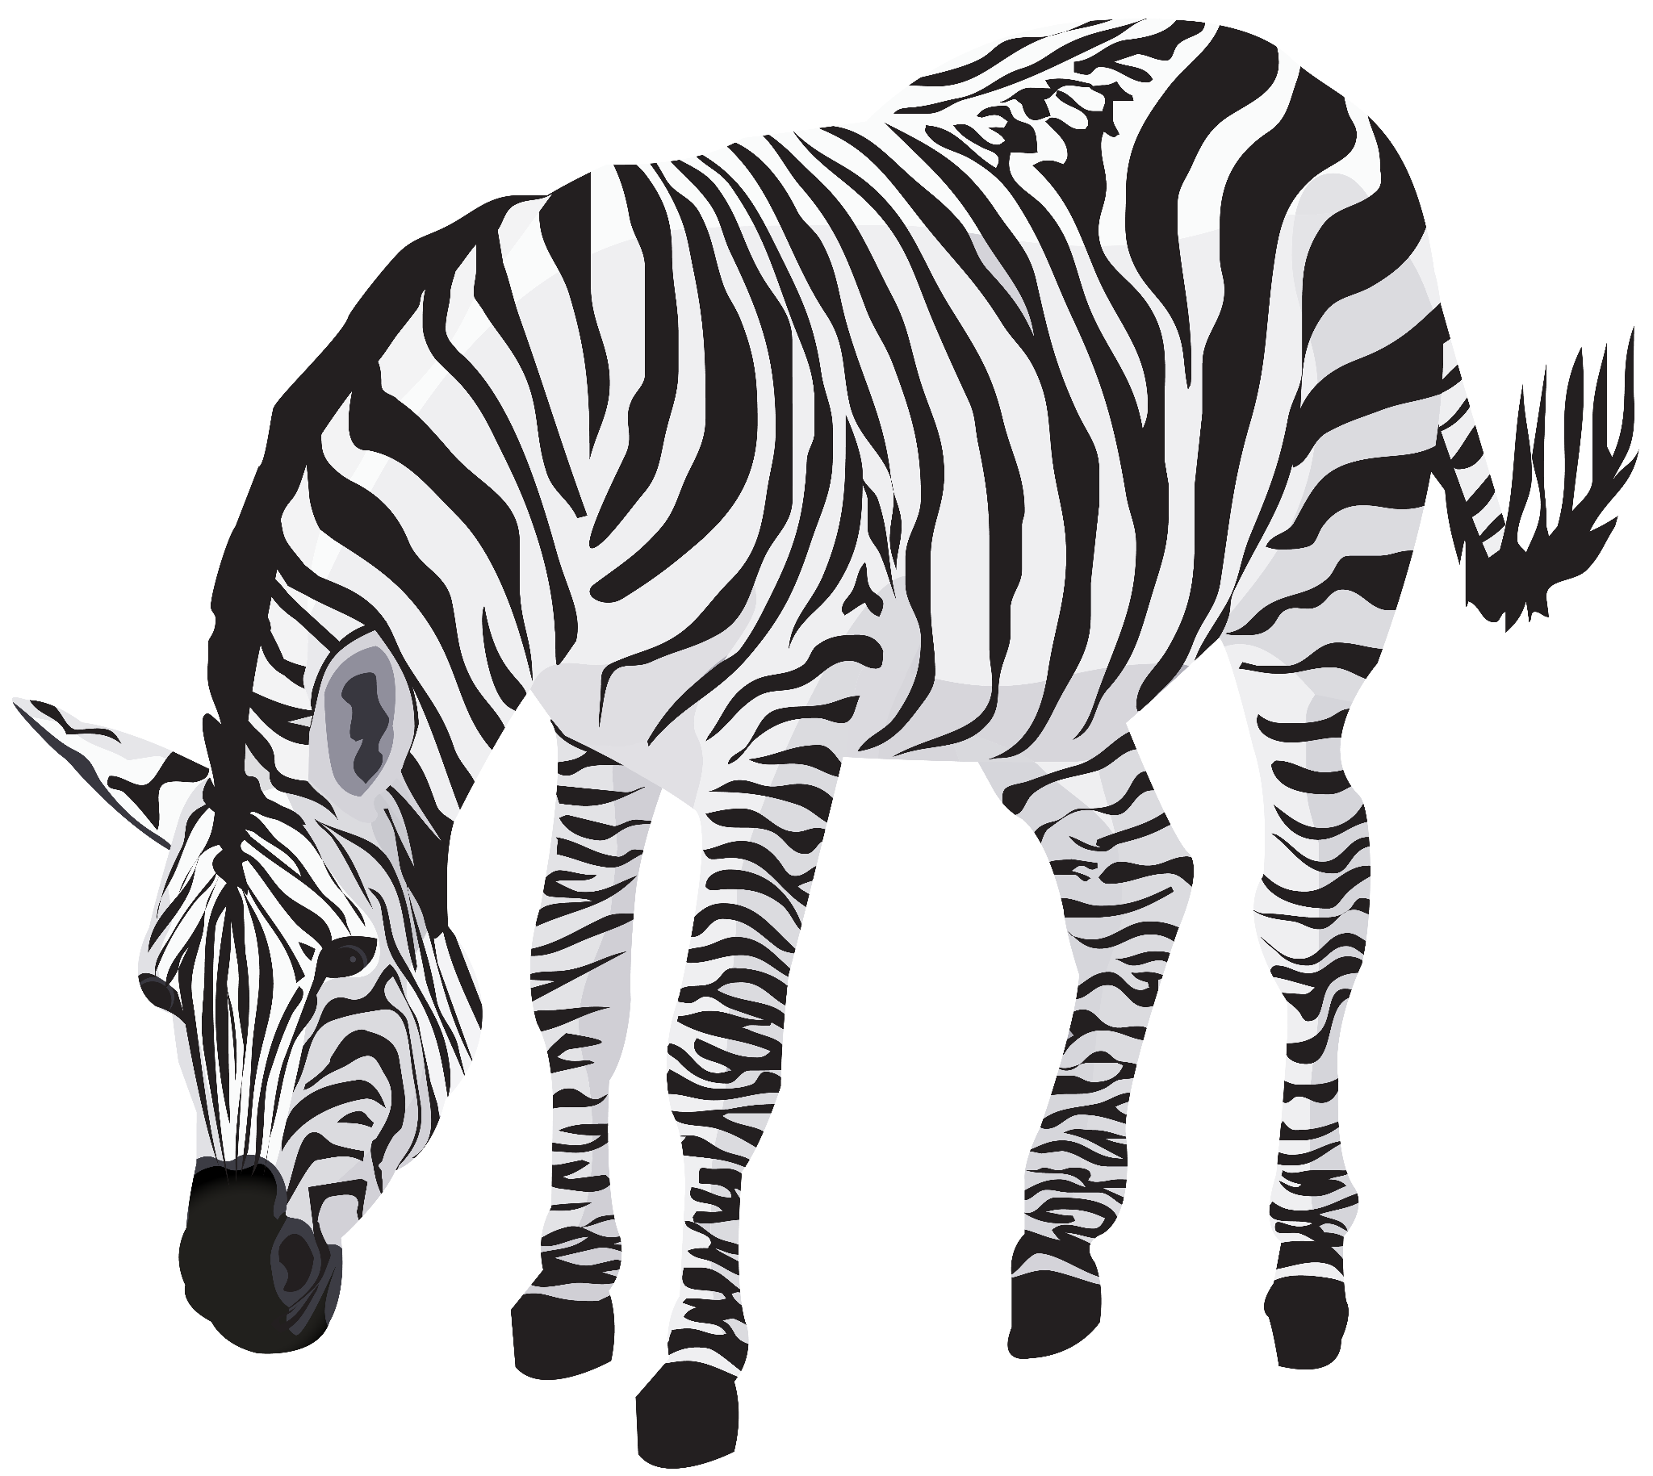
2. What will you do?

Slide 8
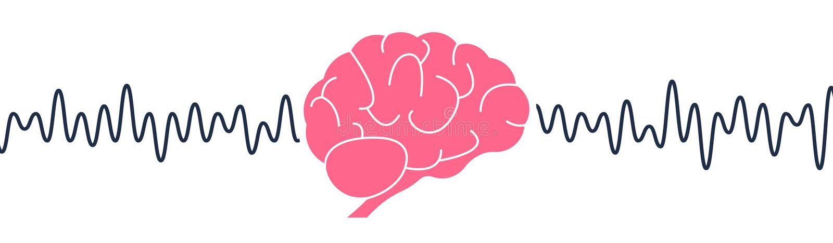
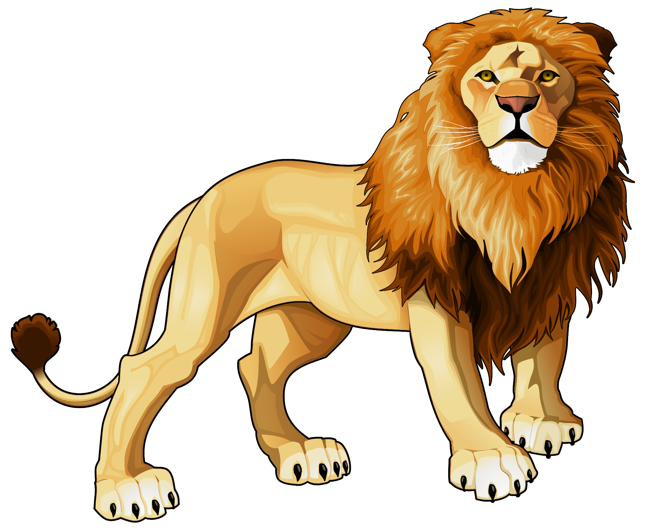
Did you know there is electricity in your brain?
To help us understand more, we would like to measure electricity in your brain using special equipment called EEG.

Slide 9
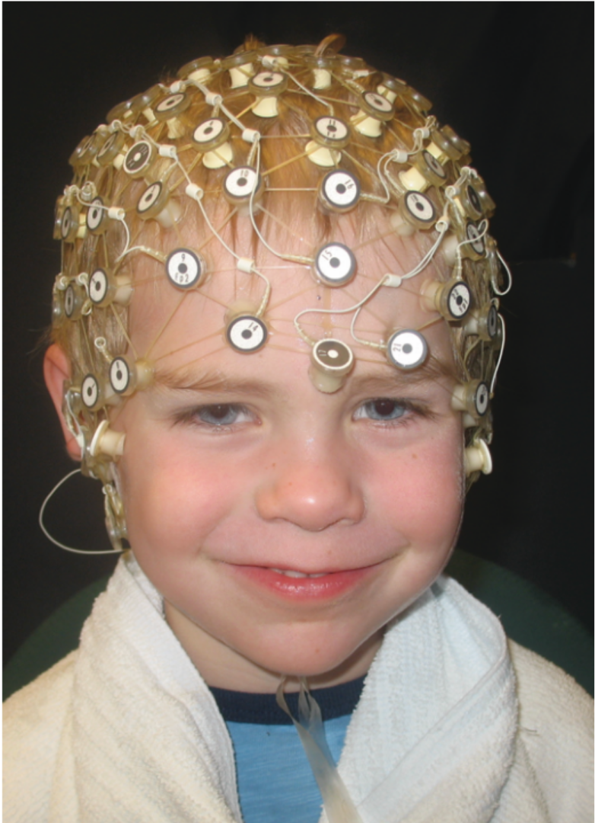
We use a hat that looks like a swim cap, and you will put it on and watch videos, play computer games and listen to sounds. The cap is wet, but it doesn’t hurt.
We can also show you your brain waves (the electricity patterns) when you are sleepy, or when you roll your eyes, or when you yawn. It is pretty cool to see. Your caregiver can take pictures of you with the EEG hat on.

Slide 10
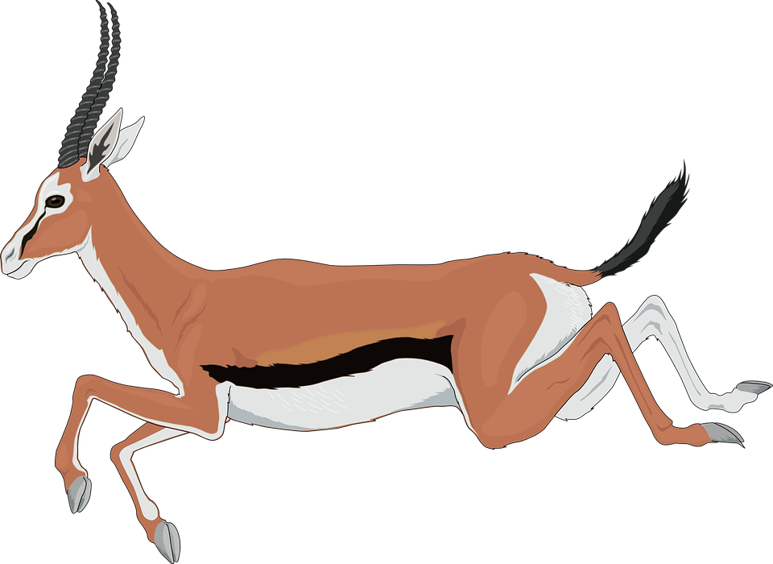
3. What else will you do?

Slide 11

You will also do some puzzles and word and memory games. You will not have the EEG hat on during this part.
Some of the questions may be really easy and some will be hard. It’s supposed to be that way!
You are not supposed to get all the questions right. We just want to learn more about how you solve problems.

Slide 12

4. What will you earn for participating?

Slide 13
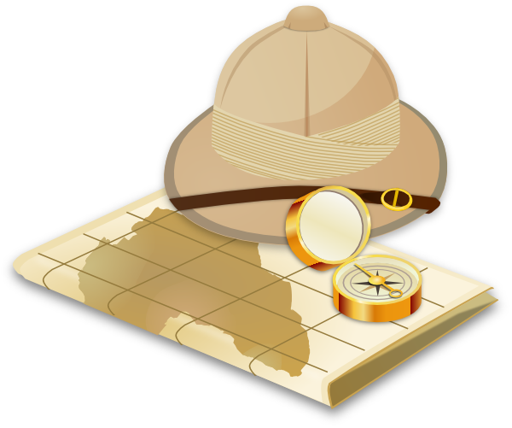
We will have prizes for you at the end and your family will earn $40!

Slide 14

THANK
YOU!
Please ask your parent to contact us if you have any questions!
-The RHINO Study Team
617-919-7771
ArnettLab@childrens.harvard.edu

